Slide 1
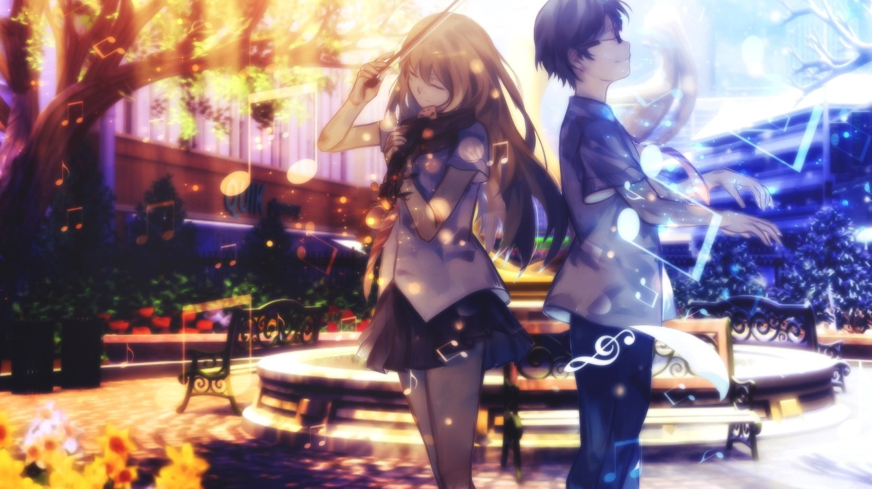
Generating Anime Characters Using StyleGAN
Varun - 2K18CSUN04024
Sagar - 2K18CSUN04014
“GAN is the coolest idea in machine learning in the last twenty years.” – Yann LeCun

Slide 2
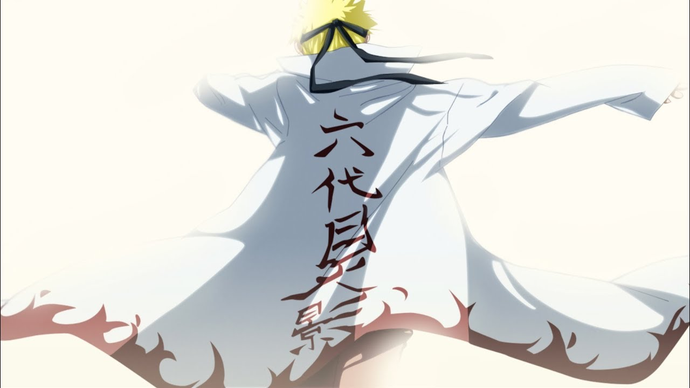
Motivation
With machine learning experiencing a soaring growth in almost all spear of life, a recent yet immensely debated topic could never have better piqued the curiosity of tech geeks as GAN does.
Amongst all of the serious wonders pulled off by this relatively new tech, we however are more inclined towards the region of our which is Japanese animation, otherwise known as anime.
Moreover, it should also be noticed that game development and animation production are rather expensive and require a lot of manual work. We, however, plan to reduce our dependencies on human resources for such tasks, and GAN comes in as a savior as it can not only auto-generate colorized anime characters but can also save us from the hassle of designing the non-playable characters (NPCs) for game titles.
However, to be put it simply, our rather persistent interest in anime and our inclination toward expanding the horizon of our previous research, “Are Anime Cartoon?,” could be consider the impending reason for us to work on this problem.

Slide 3

Introduction
Since the authors of this research paper love anime, we were charmed by them and were tempted to create our own anime characters. However, since we were not skilled in terms of drawing, we were forced to drop the idea of manually drawing the characters.
However, we didn’t want to give up on the idea of creating our own anime characters, so we decided to look into a method of developing anime characters with the help of deep learning, which is when we came across a particular deep learning based generative model, Generative Adversarial Networks [1] or GANs.
Generative Adversarial Networks is a new framework for estimation of the generative models by training two models simultaneously, a generative model G learns to generate plausible data, while a discriminative model D learns to distinguish the generator's fake data from real data. The discriminator penalizes the generator for producing implausible results.

Slide 4
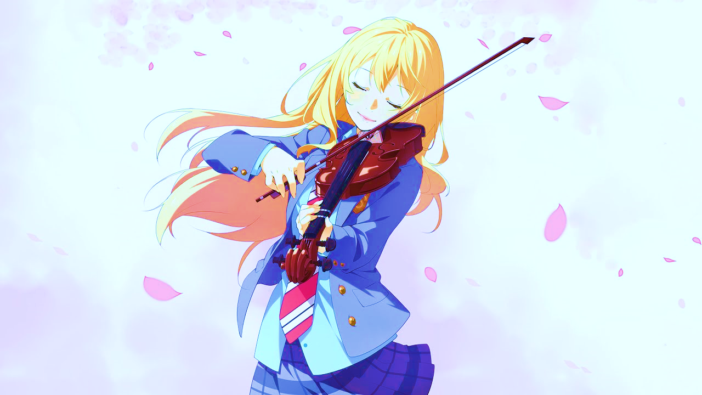
Related Work
GANSynth: Adversarial Neural Audio Synthesis
Jesse Engel, et al. in [2] proposed a GAN model namely, GANSynth, which uses a Progressive GAN architecture to incrementally up-sample with convolution from a single vector to the full sound. In their research, they show how GANs can easily outperform human evaluation, and efficiently generate music or audio faster.
Generative Adversarial Text to Image Synthesis
Scott Reed et al. [3] developed a novel deep architecture and GAN formulation to effectively bridge these advances in text and image modeling, translating visual concepts from characters to pixels. We demonstrate the capability of our model to generate plausible images of birds and flowers from detailed text descriptions.
TV-GAN: Generative Adversarial Network Based Thermal to Visible Face Recognition
Teng Zhand et al. [4] tackled the face recognition task on images captured using thermal camera. The research proposed a TV-GAN that can transform thermal face images into their corresponding Visible Light Domain images whilst maintaining identity information which is enough for the existing VLD face recognition models to perform recognition.

Slide 5
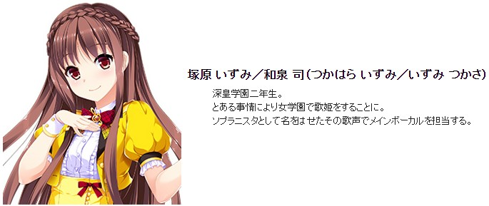
Data Collection & Preprocessing
Data Collection
Since not many researchers have invested into anime, there is no readily available and reliable dataset for our research on the internet. For a complex task like generating images, it is imperative to have a clean and high-quality dataset.
Getchu is a website that provides information about anime and Japanese games, and each of them have a character introduction page, which has a still image of a character along with the description of the character.
In the shown figure, we can see an introduction of a character along with an image from Getchu.
As we see in the figure that the character image practically clean, and has little to no unwanted data, and the quality is of acceptable level as well. Since, they satisfy the requirements for our research, we’ll be using these images in our experimentations in following sections. Since GANs require a huge amount of data, we collected about 125,000 images of anime characters.

Slide 6

Data Collection & Preprocessing
Data Preprocessing
We used a CNN based opensource model [5], which is used for detecting and extracting anime faces from an image, to extract faces from the images.
However, since our model, which is StyleGAN [6] requires a uniform data, which means that all images must have same format, meaning all images should have same the dimensions, same color scheme and same extension. So, after extracting the files, we converted all the files to jpg and used a tool called GIMP to scale all images to 512px x 512px losslessly.
Since StyleGAN only accepts .tfrecord extension, we used a special tool provided in [6]’s source code to convert all files into the desired extension.

Slide 7
Generative Adversarial Network
Generative Adversarial Networks were first introduced by Ian Goodfellow et al. [1] in 2014. They are generative models which have been proven to be effective for generating photographic imagery.
GANs are generative models that create new data instances that resemble your training data.
A generative adversarial network (GAN) has two parts:
The generator learns to generate plausible data. The generated instances become negative training examples for the discriminator.
The discriminator learns to distinguish the generator's fake data from real data.
When training begins, the generator produces obviously fake data, and the discriminator learns to tell that it's fake.
Both the generator and the discriminator are neural networks. The generator output is connected directly to the discriminator input. Through backpropagation, the discriminator's classification provides a signal that the generator uses to update its weights.

Slide 8
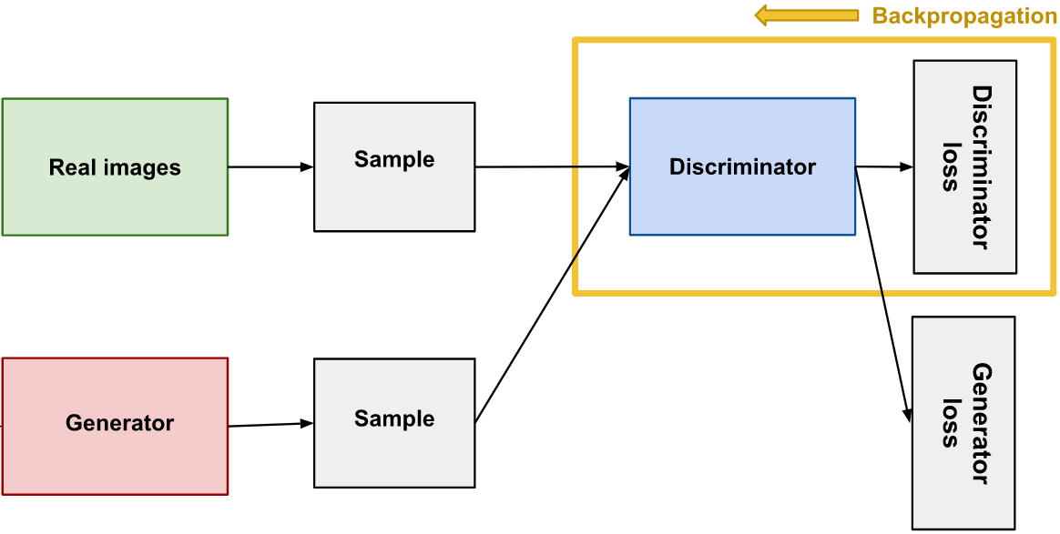
Discriminator
The discriminator in a GAN is simply a classifier. It tries to distinguish real data from the data created by the generator. Any appropriate network architecture can be used to design the discriminator.
Discriminator Training Data
The discriminator's training data comes from two sources:
Real data instances:- The discriminator uses these instances as positive examples during training.
Fake data instances:- These are created by the generator. The discriminator uses these instances as negative examples during training.
In the above figure, the two "Sample" boxes represent these two data sources feeding into the discriminator. During discriminator training, the generator does not train. Its weights remain constant while it produces examples for the discriminator to train on.

Slide 9
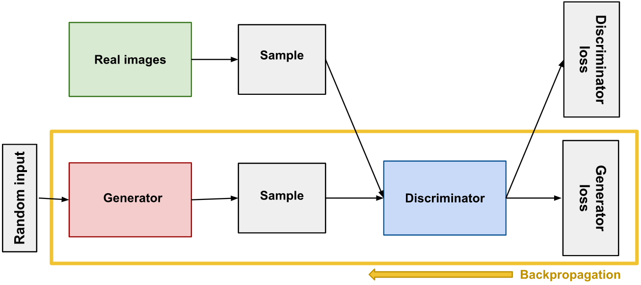
Generator
The generator part of a GAN learns to create fake data by incorporating feedback from the discriminator. It learns to make the discriminator classify its output as real.
Generator training requires higher integration between the generator and the discriminator than discriminator training requires. The portion of the GAN that trains the generator includes:
random input.
generator network, which transforms the random input into a data instance.
discriminator network, which classifies the generated data.
generator loss, which penalizes the generator for failing to fool the discriminator.
In GAN, discriminator generates the generator loss which is sent back to generator to allow it to update its weight.
Backpropagation adjusts each weight in the right direction by calculating the weight's impact on the output — how the output would change by changing the weight. So backpropagation starts at the output and flows back through the discriminator into the generator.
So we train the generator with the following procedure:
Random input.
Produce generator output from random input.
Get discriminator to classify "Real" or "Fake" for generator output.
Calculate loss from discriminator classification.
Backpropagate to change only the generator weights.

Slide 10

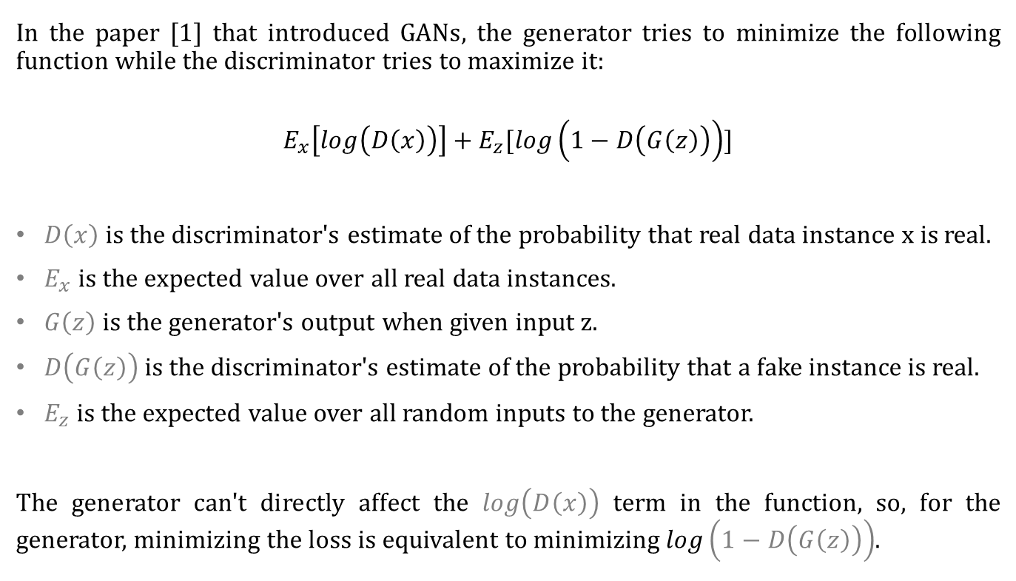
Loss Function
In the paper [1] that introduced GANs, the generator tries to minimize the following function while the discriminator tries to maximize it:
$$E_{x}\left[\log\left(D\left(x\right)\right)\right]+E_{z}[\log\left(1−D\left(G\left(z\right)\right)\right)]$$
$D\left(x\right)$is the discriminator's estimate of the probability that real data instance x is real.
$E_{x}$ is the expected value over all real data instances.
$G\left(z\right)$ is the generator's output when given input z.
$D\left(G\left(z\right)\right)$ is the discriminator's estimate of the probability that a fake instance is real.
$E_{z}$ is the expected value over all random inputs to the generator.
The generator can't directly affect the $\log\left(D\left(x\right)\right)$ term in the function, so, for the generator, minimizing the loss is equivalent to minimizing $\log\left(1−D\left(G\left(z\right)\right)\right)$.

Slide 11
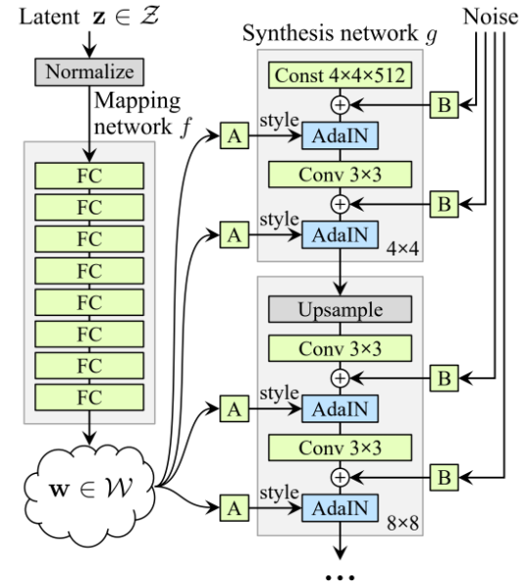
StyleGAN – Style-based Generator
However, it was noticed that traditional GANs do not perform well on anime images because bias present in CNNs that real images work because they provide a degree of texture which is absent in anime images. However, Katherine L. Hermann in [7] explained that CNNs are capable of learning of focus on shape instead of texture, however, traditional GANs are not complex enough to incorporate it. Hence, we’ve decided to StyleGAN [6], which is an advance variant of traditional GAN.
StyleGAN was released by Nvidia in December 2018. Nvidia proposed a generator that begins from an arbitrary learned constant, and modifies the style of the image, at each convolutional layer, thus allowing the control the strength of different features of image. The new architecture allows unsupervised separation of various high-level attributes texture vs linear art; however, Nvidia does not propose to modify any attribute of the discriminator in any way.
Unlike the traditional GAN, a random input is not provided, instead an arbitrary learned constant is introduced. Given a latent code z in the input latent space Z, a non-linear mapping network f: Z → W first produces w ∈ W as shown in left side of the figure.
In the above image, Nvidia demonstrated by mapping the input to a latent space W, which controls the generator by adaptive instance normalization (AdaIN) at every convolutional layer. In the figure, A is the learned affirm transform, while B is the noise input.

Slide 12
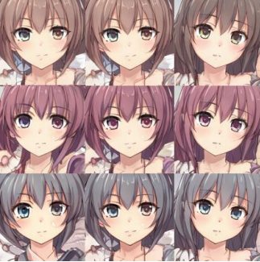

Properties of Style-based Generator
Style Mixing
The StyleGAN generator uses the latent space in each level of the network, which might cause the network to learn that levels are correlated. To reduce the correlation, the model randomly selects two input arbitrary constants instead of one and generates the intermediate vector w for them. One such example is shown below with psi = 1.
Stochastic Variations
Various stochastic features like freckles, hairstyle, etc. may prove to be computationally expensive, these issues can be solved by introducing noise after every convolutional layer.
Manipulation of Global Effects
Now, we have established the fact the introducing noise only affects stochastic attributes, while any changes to style affect global effects, such as change in pose or lighting.
This thesis has been supported by style transfer-literature [8] where it has been concluded that since feature maps and scaled and biased, the style affects the entire image in the style-based generator. Hence, global effects can be controlled.

Slide 13

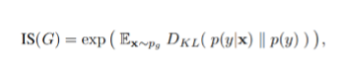
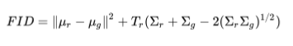
Performance Evaluation
Since this is a problem based on unsupervised learning, there exists no universally-accepted or objective method to evaluate the performance of our model. However, there are a few common methods that are generally used to determine the performance in a relative manner, which is why we decided multiple metrics to evaluate our model, some of which are given as follows.
Inception Score
It takes a list of images and returns a single floating point number, the score. The score is a measure of how the output is related to the training data. In the words of its authors, “we find [the IS] to correlate well with human evaluation [of image quality]”. It is an automatic alternative to having humans grade the quality of images.
The score measures whether the images have variety and if each image distinctly looks like training data. If both things are true, the score will be high. If either or both are false, the score will be low. A higher score is better.
Frechet Inception Distance
The Frechet Inception Distance (FID) is a metric that calculates the distance between feature vectors calculated for real and generated images.
The score summarizes how similar the two groups are in terms of stats on computer vision features of the raw images calculated using the inception v3 model used for image classification. Lower scores indicate the two groups of images are more similar. The FID score is used to evaluate the quality of images generated by generative adversarial networks. A lower score is better.
Perceptual Path Length
Perceptual Path Length is a metric that was originally intended to control the smoothness of the mapping from the latent space to the generated images by measuring the well-known LPIPS distance between the synthesized image with small disruption in the latent space. Low PPL score are generally indicative of higher quality.

Slide 14
Experiments, Result & Analysis
The experiments were carried out on both local machines and cloud-based virtual machines. The local experimental setup included the following specifications:-
Intel® Core™ i7-8700K Processor
Nvidia GeForce RTX 2080
64 GB DDR4 @ 2,400 MHz Memory Module
While we tried several different cloud-based virtual machines with different specifications. We tried different GPU instance to find out which specification would require the least amount of time for training our model. The different GPU instances have been formulated below.
From the above table, we can conclude the Nvidia Tesla V100 required the least amount of time to train our input images, which were all of dimension 512px x 512px.
VM GPU Instance | No. of GPUs | Time Taken | VRAM
P2.xlarge | 2 | 5 days & 12 hrs. | 12 GB
Nvidia Tesla K80 | 8 | 4 days & 10 hrs. | 24 GB
Nvidia GeForce RTX 2080 | 1 | 11 days & 9 hrs. | 8 GB
Nvidia Tesla V100 | 2 | 3 days & 1 hr. | 16 GB

Slide 15
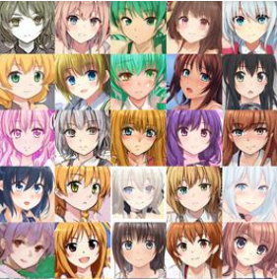
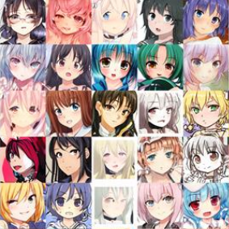
Hyper-Parameters Tuning & Qualitative Results
Since our model is fundamentally build upon the same architecture as employed by Nvidia Labs in their implementation of Style GAN 2. Most of the parameters are same as originally used by the Nvidia to perform their experiments. However, we've made a few changes to some other parameters, and the best results were shown by employing Adam optimizer with hyperparameters (β1 = 0.1, β2 = 1 for a minibatch size of 32 and learning rate of 0.01).
Generated samples for truncation psi = 0.5 for different random samples
Generated samples for truncation psi = 0.7 for different random samples

Slide 16
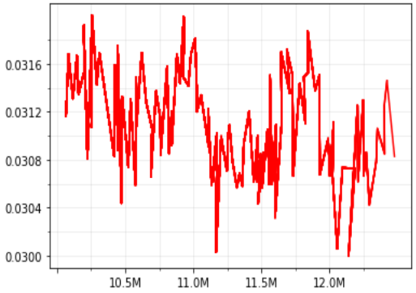
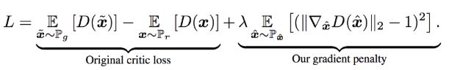
Quantitative Results
As we have seen the visual results of our experiments, we were very satisfied with the outcome. For our experiment, we trained our model for 25,000 ticks (epochs), and the final results were collected after all the epochs have been completed. Aside of a good FID and IS score, we also saw a decent drop in penalty loss as well after it iterated over 12 million kimages. The metric and score has been tabulated in the given table.
However, it may be noticed that different values of psi do not affect the metric score. Psi is merely a parameter for variation, as shown earlier.
The graph showing the penalty loss has also been shown below.
Fig - Our model shows convergence for penalty loss of about 0.0308.
Metric | Score
FID | 59
IS | 8.13 ± 0.01
PPL (zfull) | 400 ± 3.2
PPL (wfull) | 126.9 ± 0.2
PPL (zend) | 456.6 ± 2.08
PPL (wend) | 130 ± 0.8

Slide 17
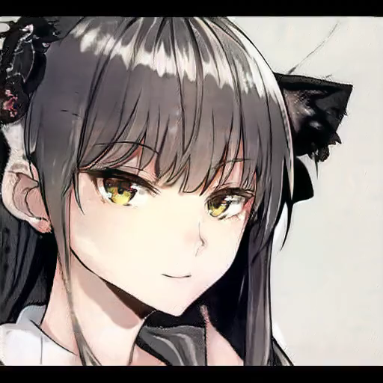
Interpolation with Style Mixing
Here we notice the style mixing feature of style GAN version 2 that mixes the features learned at a relatively lower resolutions such as the basic shapes of the face, etc with the features learned at relatively higher resolutions(512px X 512px) such as colour of the eyes, facial expressions, hair colors, etc.

Slide 18

Conclusion & Future Work
In this presentation, we discussed about GAN and StyleGAN, a variant of generative adversarial network introduced by Nvidia, and how it was suitable for our research, instead of the traditional or vanilla GAN. Since, anime characters lack textures unlike real human beings, and StyleGAN adapts to the situations, lacking in the such properties, to produce start-of-the-art images. Since, there exists no universally accepted metric for evaluation, we decided to use multiple commonly accepted methods, such as Inception Score (IS), Fréchet Inception Distance (FID) and Path Perpetual Length (PPL) to determine the quality of our generated images. We used different values to psi to check the variation in the images.
In this, we talked about create anime characters. In future, we plan to see if it is possible to animate those generated characters through deep learning. If there exists such a method, we intend to see how we can adapt such method, and possibly improve it further by performing several different experiments. Moreover, we'll also investigate ways to improve our current model even further.

Slide 19

References
[1] Ian J. Goodfellow, Jean Pouget-Abadie, Mehdi Mirza, Bing Xu, David Warde-Farley, Sherjil Ozair, Aaron Courville, Yoshua Bengio, “Generative Adversarial Networks”, 2014
[2] Jesse Engel, Kumar Krishna Agrawal, Shuo Chen, Ishaan Gulrajani, Chris Donahue, Adam Roberts, "GANSynth: Adversarial Neural Audio Synthesis", 2018
[3] Scott Reed, Zeynep Akata, Xinchen Yan, Lajanugen Logeswaran, Bernt Schiele, Honglak Lee, "Generative Adversarial Text to Image Synthesis", 2016
[4] Teng Zhang, Arnold Wiliem, Siqi Yang, Brian Lovell, "TV-GAN: Generative Adversarial Network Based Thermal to Visible Face Recognition", 2018
[5] https://github.com/nagadomi/lbpcascade_animeface
[6] Tero Karras, Samuli Laine, Timo Aila, "A Style-Based Generator Architecture for Generative Adversarial Networks", 2018
[7] Katherine L. Hermann, Simon Kornblith, "Exploring the Origins and Prevalence of Texture Bias in Convolutional Neural Networks", 2019

Slide 20
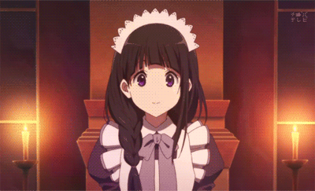
Thank You!

